Slide 1
Corrections
Officer
Retirement
Plan
Member Reporting

Slide 2


outline
Introducing the corp local board members & staff for the aoc.
Corp Local board and staff role & responsibilities
Annual audit
Member Reporting
New Member Information, Links & Contacts
SUMMARY

Slide 3
Introducing the corp local board Members & staff

Slide 4
Corp local board Members
Kevin Kluge
Board Chair
Chief Justice Appointee
Scott Mabery
Board Member
Chief Justice Appointee
Jennifer Fish
Board Member
Chief Justice Appointee
Brandon Shimizu
Board Member
Elected Member
Jason Hathcock
Board Member
Elected Member

Slide 5
Corp local board staff
Kayla Adkins
Local Board Secretary
kadkins@courts.az.gov
Alexi Papalossi
Local Board Staff
spapalossi@courts.az.gov
President
Chief Executive Officer
Chief Operations Officer
VP Marketing

Slide 6

Corp’s role
The Corrections Officer Retirement Plan (CORP) is a program that tracks and records information provided by eligible State of Arizona Public Safety AOC employees and their employers throughout their membership.

Slide 7
Corp’s responsibilities
CORP is responsible for tracking and documenting information regarding members and their benefits. This information is used to determine eligibility for retirement and disability benefits.
Public Safety Personnel Retirement System (PSPRS) handles all financial aspects of the membership.

Slide 8
Annual audit
The AOC CORP Local Board conducts the annual audit, comparing county and PSPRS records.
During the 2024 CORP Membership Audit, the CORP Local Board found over 30 discrepancies across 15 counties.
Discrepancies included: missing term dates, enrollment forms, and missing members.
The CORP Local Board’s goal is to keep the discrepancies to a minimum every year.
Let’s talk about how we can work to achieve this goal.

Slide 9
Member reporting

Slide 10
County HR’s Role
Promptly report any member changes to the CORP Local Board and PSPRS.
  New Employment
  Transfer from county to county
    Example: Transfer from Pima County to Maricopa County
  Promotions/Title Changes
  Termination/Resignation
  Retirement
  CORP Retiree Returning to Work
  Requests to Remain in ASRS
Work closely and diligently with CORP Local Board staff on behalf of the employee to make sure all pertinent information is shared.
Provide the employee with necessary information regarding their plan selection.

Slide 11
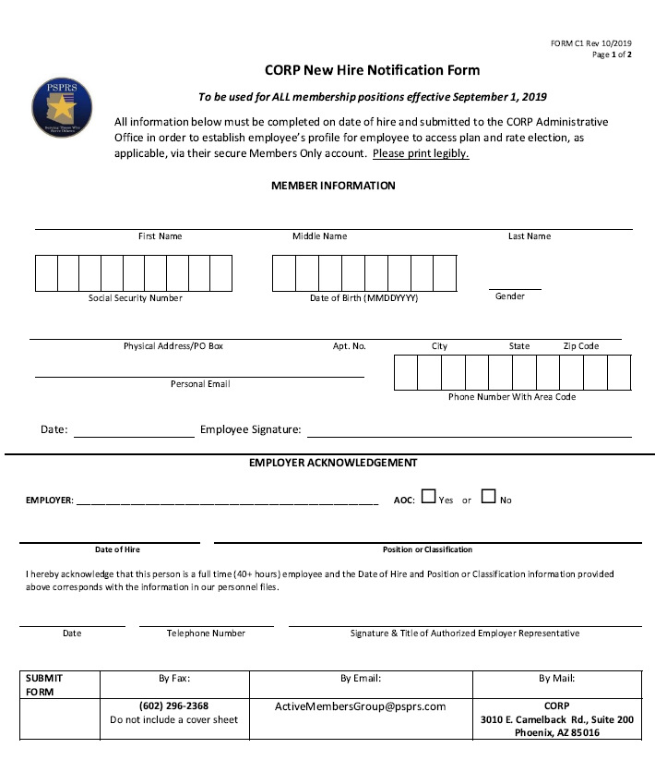
Prospective CORP Members rely on their employer and The CORP Local Board Staff working together, diligently to provide and record their information for the CORP Board to review.
CORP-eligible members have 90 days from the hire date to complete a physical exam and choose a retirement plan.
Returning CORP members must complete a new physical exam.
CORP does not require members to see a specific provider, but they do require specific forms to be submitted for review.
This form is used to identify new hires and promotions/ title changes.

Slide 12
Terminations/ Resignations & Retirement
County HR notifies Local CORP Board with :
Members Name
Type of Change
Last 4 of Member’s SSN

Slide 13
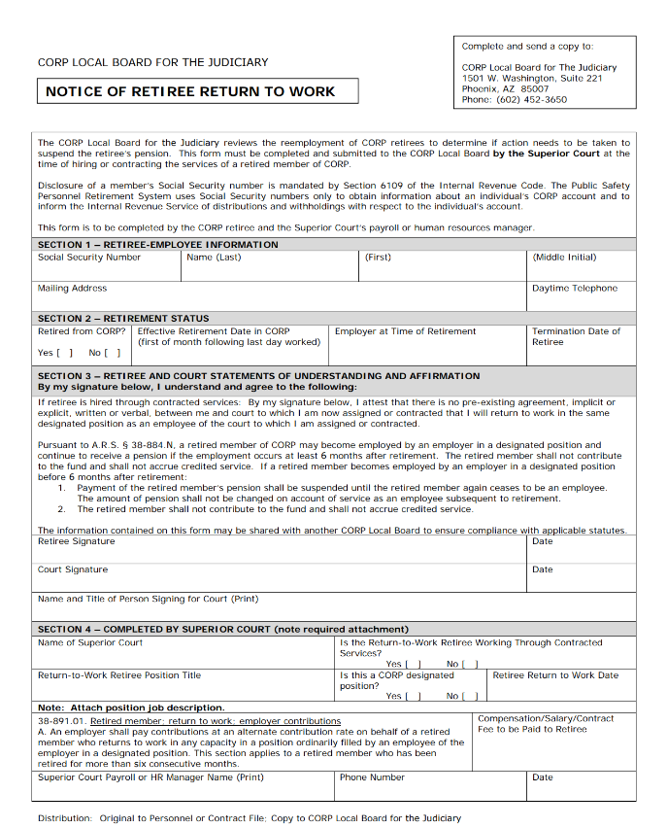
Retiree Returning to work
County HR notifies CORP Local Board staff of the member's information, as well as the completed "Notice of Retiree Return to Work" form.

Slide 14
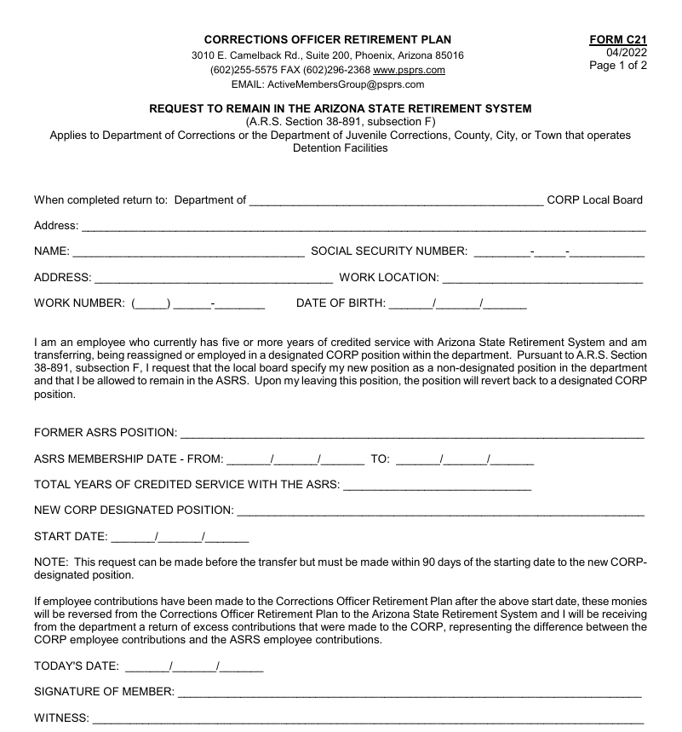
Request to Remain in ASRS
County HR sends CORP Local Board staff with the completed Form C21 – Request to Remain in ASRS and the member’s previous and new position descriptions.

Slide 15
New hire Information, Links & Contacts

Slide 16
The links below are used to access pertinent information.
New member enrollment process
Form C1 - New Hire Form
PSPRS – PSPRS
AOC Probation and Surveillance Officers - AOC Probation and Surveillance Officers – PSPRS
Public Safety Financial/Galloway - Public Safety Financial/Galloway
PSPRS Forms and Resources - Employers – PSPRS
CORP website - Corrections Officer Retirement Plan

Slide 17
  Contact Information
  PSPRS Email:
  activemembers@psprs.com
  PSPRS Phone:
  602-255-5575
  ______________________________________
  CORP Email:
  CORP@courts.az.gov
  CORP Phone:
  602-452-3650

Slide 18

SUMMARY
CORP Members count on county HR staff and CORP Local Board staff to work together to ensure they are reported to the CORP Local Board for membership approval. Having a strict reporting deadline, timely communication between county HR staff and CORP Local Board staff is crucial and necessary for a smooth process.

Slide 19
Questions?

Slide 20
THANK YOU
Kayla Adkins – Local Board Secretary
kadkins@courts.az.gov
Samuel ‘Alexi’ Papalossi – Local Board Staff
spapalossi@courts.az.gov

